Slide 1
Open Hospital roadmap

Slide 2
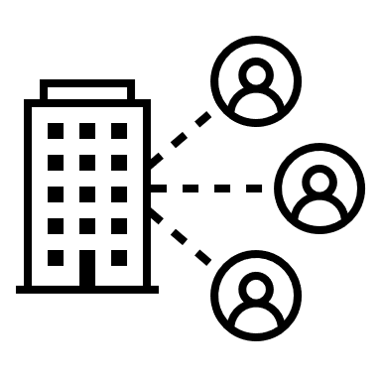
Open Hospital project
To provide a simple and core features for hospitals with scarce resources, yet giving reliable and versatile software for daily activities.
Moreover, some vertical projects aim to cover specific needs, like chronic diseases and epidemics, or to reach the patients at home, improving the care delivery.

Slide 3
openhospital-core
openhospital-api
openhospital-ui
openhospital-gui
openhospital-doc
Open Hospital stack
June 2022

Slide 4
Open Hospital components
core
It’s the heart of the application
api
application programming interface
ui
user interface (wip)
gui
user interface (current)
The heart of the application
Contains the main features as patient management, admissions, visits, billing, therapies, pharmacy and general application settings
Exposes main features of core, enabling other sofwares to authenticate and to operate with the application
A modern and responsive user interface
The current and most robust user interface for the whole application
June 2022

Slide 5
Open Hospital development
core
core is continuosly updated (latest v1.11.3)
See Jira issues
api
api development follows AND/OR drives core from ui design
ui
ui development is under go as ReactJS single page application, adding new user experience and features
See Jira issues
gui
gui development is meant to make it as stable as possibile for the main application features.
In the future, it may welcome or not, or just partially, new features in core
June 2022

Slide 6
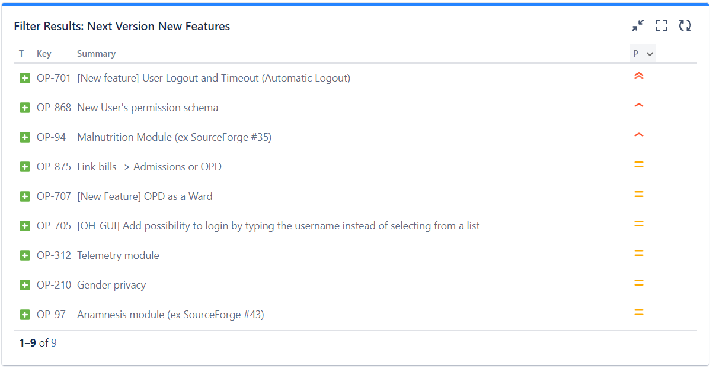
Open Hospital next version
See Jira issues for v1.12.0
June 2022

Slide 7
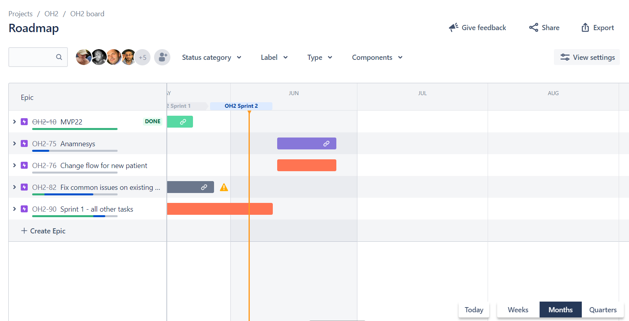
Open Hospital 2.0
See Jira issues for v2.0
roadmap
OP-159
June 2022

Slide 8
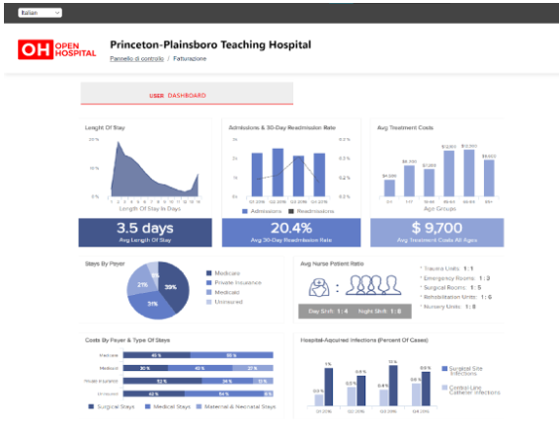
Open Hospital for people
To address new requirements for privacy and confidentiality. More stringent solutions for the treatment and management of health information, to protect the patients rights.
See Jira issues for GDRP and SEC
A Patient Portal to offer a core of features to patients in order to lead them to a more modern way to access their data and get better services.
(read more...)
GDRP & SEC
Patient Portal
We aim to provide a "landing page" for authenticated users, to show a dashboard with personalised insights and useful information using the collected data.
(read more...)
We believe in open source for better software!
You can reach out to the community of contributors by joining our Slack workspace or by subscribing to our mailing list.
UI Dashboard
Community
June 2022

Slide 9
Open Hospital 2.x
SaaS
Software as a Service
client
client side component
daemon
daemon component
listen to our users
To offer zero-cost, hassle free installations for the hospitals that can afford a reliable Internet access and LAN
Ensure communication with a number of devices, such as POS Printers, GSM devices, Scanners, Fingerprint, Medical Instruments
Run a number of activities in background, such as automatic reports, automatic backups, tables historicization, sync with SaaS, sync with Patient Portal
Improve users feedback report and grow the community
June 2022

Slide 10
How to balance between…
«loose» software for small clinics…
«I just want to collect data»
«I use what I need»
«rigid» software for complex processes…
«I need help in segregation of roles and permissions»
«we have many employees with different roles»
«I have a single data entry point»
«I need connection with insurances»
«we have a specific policies for exempted patients and laboratories»
How should work an automatic billing system
How should the drugs been prescribed and given
Should the pharmacy able to work as standalone Point of Sale
Should the laboratory exams been requested and signed
June 2022

